Slide 1
Labs-variable important (SVM)

Slide 2
What Should Students do in variable importance Lab Session
Preparation
Complete the Code
Do the task and send the task requirement to the EE-CLASS

Slide 3
A. Preparation
Tools
Installed Matlab
Prepare the data and the files
Download the data in the eeclass system
You must have:
a workspace named LabFW.mat (It contains data for each class and SVM model)
Word file of Variable Importance Lab session
PPT file to check step by step how to find variable importance
Copy the code of Lab Session Word file then save it in the same folder with the data (LabFW.mat)
Add the code and data to Matlab path

Slide 4
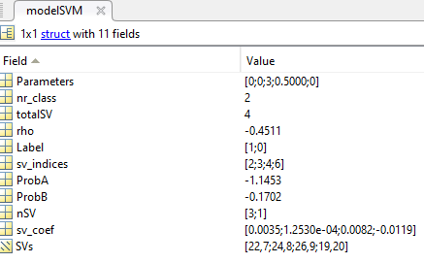
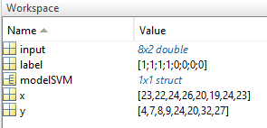
B. Complete the code
Find the variable importance
Load workspace of LabFW.mat
Perform variable importance
Sort the variable importance as descending order
Load workspace of LabFW.mat (It contains data for each class and SVM model)
load('LabFW.mat')
Class

Slide 5


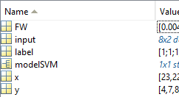
b. Complete the code
Perform variable importance
Sorted as descending order
$$FW=abs({modelSVM.sv_coef}^{′}∗modelSVM.SVs)$$
$$sortedFW=sortrows(FW′,2,^{′}descend′)$$
Rank | Feature | FW value
1
2
Describe the result which one has the highest rank
Describe the meaning of the highest rank of VI

Slide 6
C. Do the task and send the task requirement to the EE-CLASS
Use MATLAB to run the code and add screenshots to report in Word files.
Compress(.zip,.rar) the following file with the name of the group ( e.g. group_1.zip)
Code(*.m)
Report(*.doc)
Result of variable importance.
Conclusion of result.
To update the contents of report can be directly re-upload file with the name of version (e.g. Group_1_v2.zip)

